Slide 1
Star pattern recognition in astronomical images
Adding meta data to astronomical images
Han Kleijn, www.hnsky.org
This work is licensed under a Creative Commons Attribution 4.0 International License
Draft

Slide 2
Introduction
Contains:
Brief description of the ASTAP program development, applications.
Brief description how an astrometric (plate) solver works.

Slide 3
Development of ASTAP
HNS_FITS Simple FITS viewer and manual two reference star solver (2001)
Succeeded by ASTAP Astrometrical STAcking Program (2017)
  Release milestones:
  2016 The .290 star database format developed for HNSKY planetarium, first release of the Gaia version.
  2017-11, Stacking using Astrometry.net & PlateSolve2
  2018-03-14, Adding Internal star alignment for stacking.
  2018-04-19, Added internal solver

Slide 4
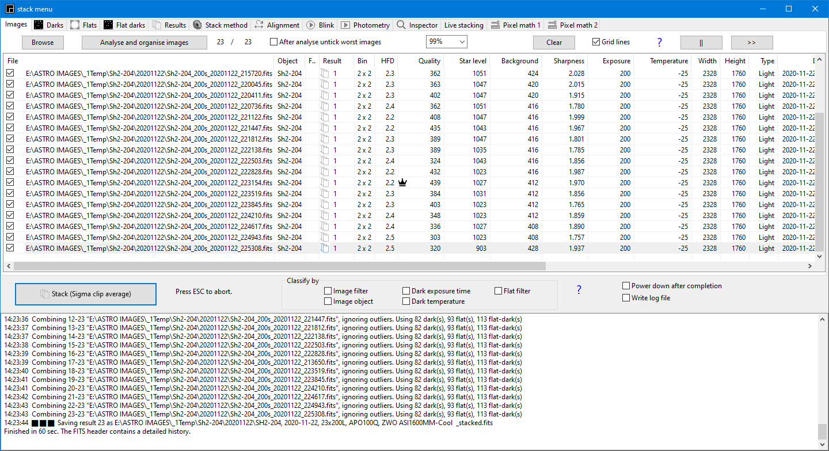
Applications
Astrometric solver for mount alignment.
Stacking of astronomical images

Slide 5
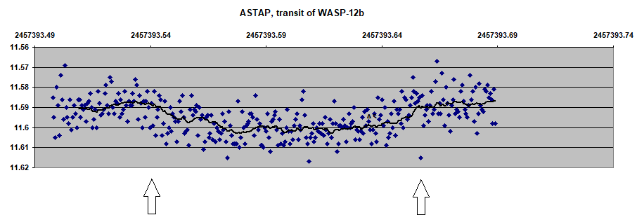
Application: photometry
Measure and export selected star magnitude

Slide 6
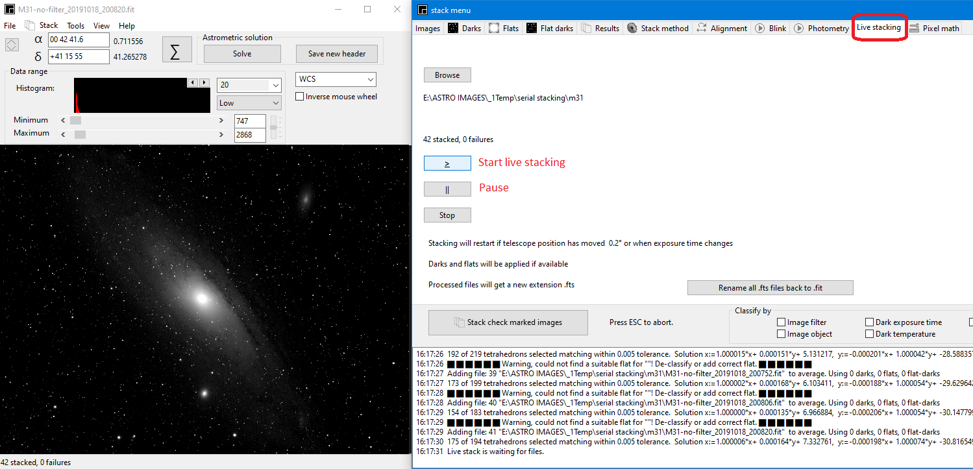
Application: live stacking

Slide 7
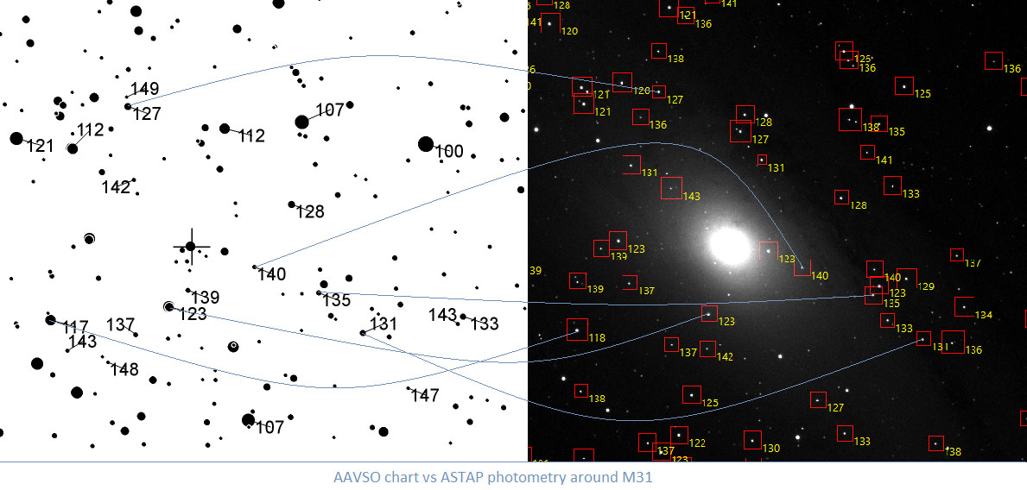
Application: photometry 2
AAVSO versus ASTAP

Slide 8
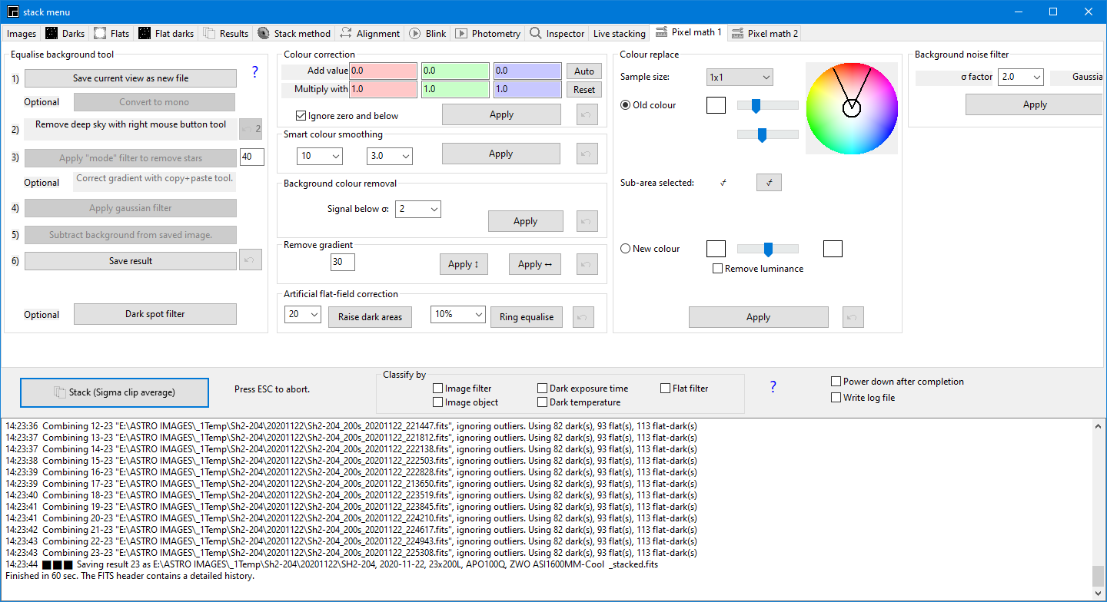
Background equalising and other tools

Slide 9
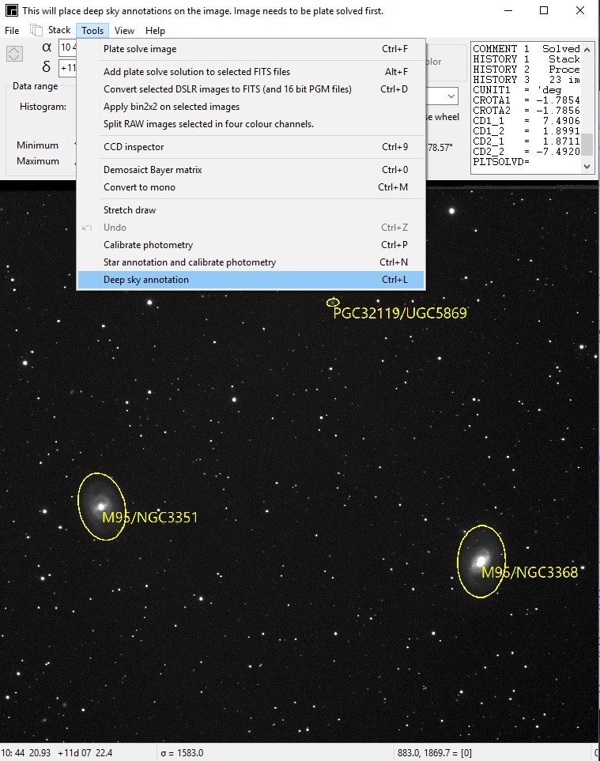
Application: annotation
Deepsky
Hyperleda
Variable stars

Slide 10
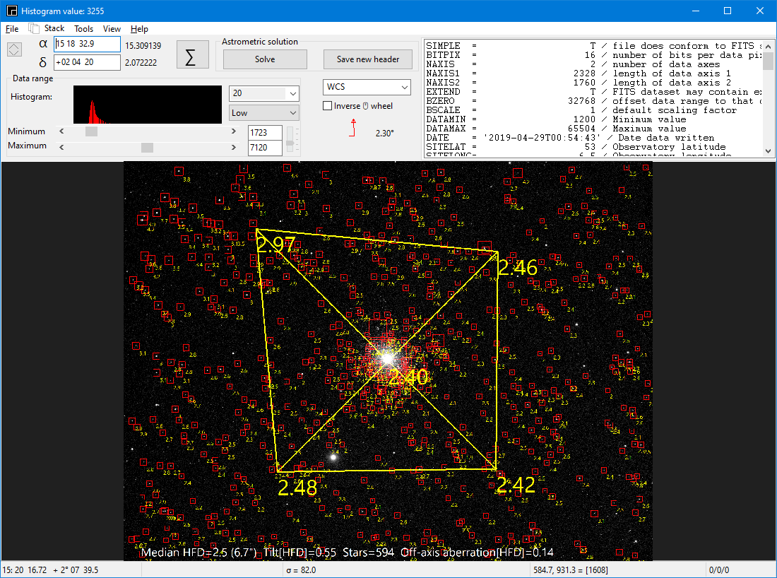
Application: inspector

Slide 11
Stacking workflow
Indentify the stars in an image.
Build quads (four closest stars)
Calculate the hash pattern for each quad (the six star distances).
Match the found quads with the reference image quads. Calculate the solution
Add the image pixels to the correct place in the stack using the solution.

Slide 12
Solver workflow
Indentify the stars in an image.
Build quads (four closest stars)
Calculate the hash pattern for each quad (the six star distances).
Find a match between the image hash codes and the hash codes of an artificial image build with the database.
Calculate an solution and model the α, δ position of each image pixel.

Slide 13
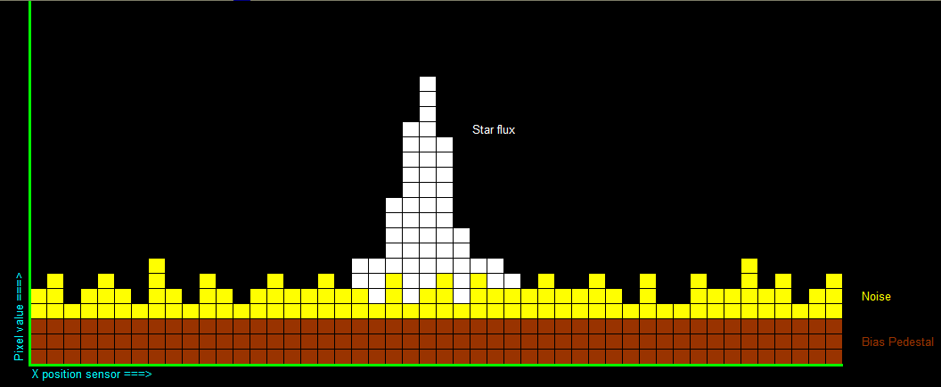
Star identification
Measure the local average background (bias + average total noise)
Measure the total noise.
Measure the star flux.
Calculate the star X,Y position at centre of gravity with sub pixel accuracy..

Slide 14
Hash coding stars combinations
Star distances and or angles
Pairs (2) , triangles (3), quads (4) or quints (5)?
Numbers of stars in the sky up to
  Mag 16, 60 million stars
  Mag 17, 105 million stars
  Mag 18, 208 million stars
ASTAP uses four closest stars (quads) and measures the (angular) distances between them.➔ Star density of image and reference should be similar.

Slide 15
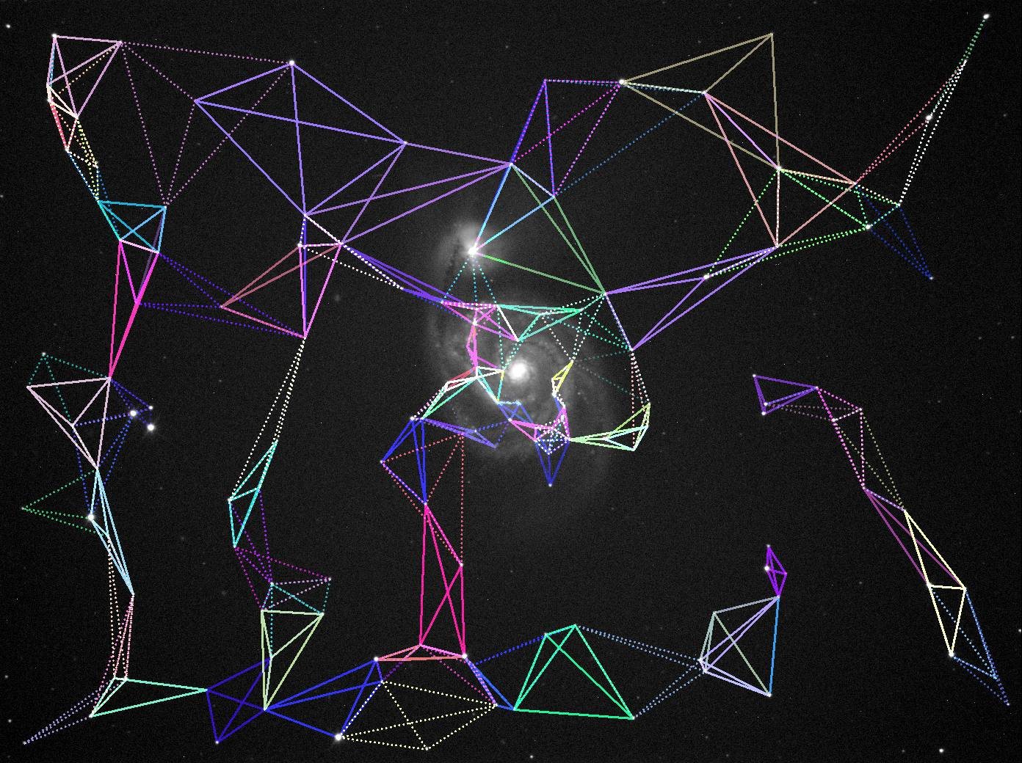
Detected quads:

Slide 16
Hash code/Pattern matching
Star matching works both between images (for stacking) and an image and a star database.
Stacking experience was a test field for astrometric solving.

Slide 17
Quad hash code
4 stars give 6 distances e1, e2, e3, e4, e5, e6
Calculate largest distance and 5 ratios.
Largest distance: 3"
Five ratios: 2/3, 1/3, 0.7/3, 0.6/3, 0.5/3
The five ratios are sufficient for the search.
Rotation, scaling, flipping of the image has no influence on the "five ratios".
The "largest distance" is later used to detect outliers.

Slide 18
Searching through the database
From the star database numerous artificial images are created using the same star density per degree following a search pattern around the initial α, δ position.
The artificial images hash codes are compared with the hash codes of the image to solve. This is the actual search. Only at about the image location a part of the hash codes will match within a small tolerance.
The "largest distances" should have a fixed ratio between the image and artificial database image. (outlier detection)

Slide 19
Six plate constants
The test image centre, size and orientation position will be different compared with the reference image.
The required conversion from the test image [x,y] star positions to the same stars on the test images can be written as:
Xref : = a*Xtest + b*Ytest + c
Yref := d*Xtest + e*Ytest + f

Slide 20
Solution keywords in FITS header
CRPIX1 = … / X of reference pixel
CRPIX2 = … / Y of reference pixel
CRVAL1 = … / RA of reference pixel (deg)
CRVAL2 = … / DEC of reference pixel (deg)
CD1_1 = … / CD matrix to convert (x,y) to (Ra, Dec)
CD1_2 = … / CD matrix to convert (x,y) to (Ra, Dec)
CD2_1 = … / CD matrix to convert (x,y) to (Ra, Dec)
CD2_2 = …/ CD matrix to convert (x,y) to (Ra, Dec)

Slide 21
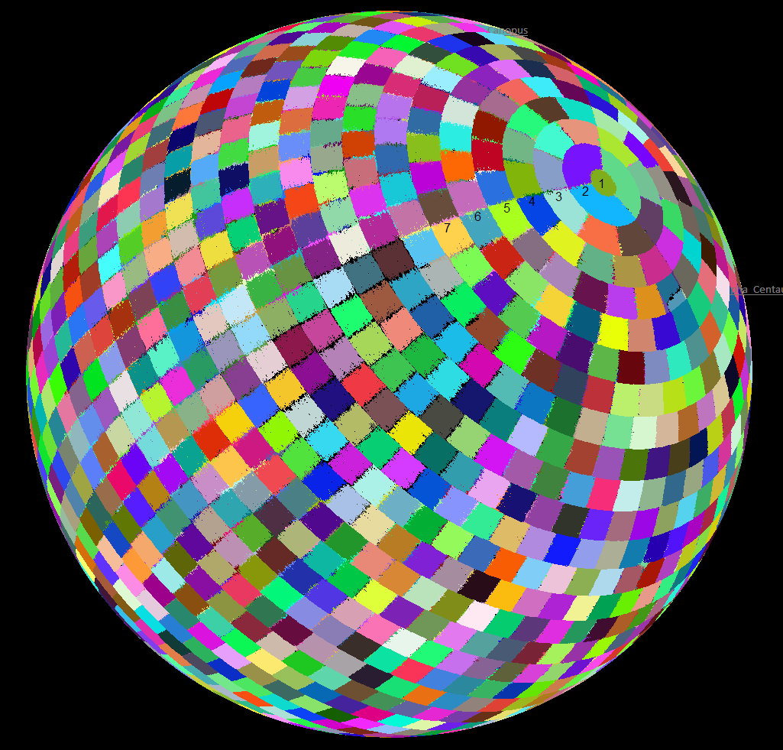
The 1476 fields of the star database
Design criteria:
Field boundaries are lines of constant α and δ .
Step size is 90/17.5 equals 5.143° or larger

Slide 22
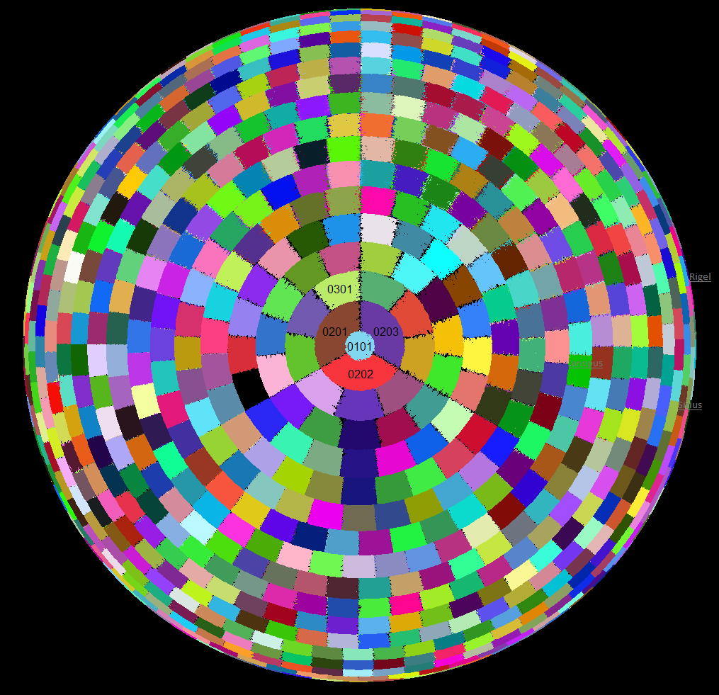
The 1476 fields of the star database

